Slide 1
Library Guidance for TAs of First-Year Seminar of the International Programs

Slide 2
Contents
Aims of today’s guidance
2. Key points on “How to use the library”
Using the library
Searching for books and journals（in OPAC）
Finding and obtaining materials
When you need help
3. Additional details for the guidance
4. Experience a standard library tour

Slide 3
１. AIMS of ToDAY’s GUIDANCe
What kind of support can the library provide?
Important lecture points
Aims of this library guidance
Why do we want new students to become skillful in using the library?
Holding a lecture/tour on “How to Use the Library”
Report on the lecture/tour TA’s conduct

Slide 4
1.1 Aims of this library guidance
The key Points of the lecture/guidance（Library Tour)
Library services and facilities
Rules, manners and skills on searching for information
→ Double check your knowledge and skills before teaching
Support desk (service, training course, etc）
→ Introduce students in case they need support
Guidance for the period of First-Year Seminar
Searching, selecting and evaluating information
Training for TAs
Teaching skills

Slide 5
1.2 Why do we want the new students to become skillful in using library?
First-Year Seminar
Learning the ways of conducting profound and interesting research via versatile mental training which is based on planning the enhancement of common basic skills such as reading, writing and listening. -- Syllabus
Learning the basics of living as a member of society
What is “Information Literacy”?
To be able to determine the nature and extent of the information needed
To be able to access needed information effectively and efficiently
To be able to evaluate information and its sources critically and to incorporate selected information into his or her knowledge base and value system
To be able to use information effectively to accomplish a specific purpose individually or as a member of a group
To be able to understand many of the economic, legal, and social issues surrounding the use of information. Access and use information ethically and legally
(Information Literacy Competency Standards for Higher Education, American Library Association)

Slide 6
1.3 Holding a lecture/tour on “How to Use Library”
Model course
Please hold a guidance using the model below. Combination of a virtual tour and a lecture is encouraged. Please contact your teacher regarding time and allocation.
Course | Content
1【Standard】 | Virtual Library tour with library material search
2【Optional】 | Searching for books and journals –The basics of OPAC Search–

Slide 7
1.4 Report on conducting the TAs’ Tour
How：Fill in and send the reporting form on the assisting page
Duration：until the end of December
Contents of report
Conducting or not conducting the lecture:
In the case of conducting, specify the date and time
In the case of not conducting, specify the reason
Contents of the lecture
Impression, etc.

Slide 8
2. key points oN “How to use THE library”
Using the Library
Searching for books and journals（OPAC）
Finding and obtaining materials
When you need help

Slide 9
2. Key points on “How to use The library”
At the beginning・・・
When you entered university・・・
When was the first time you used library?
What was your impression of library?
How do you use library now?
How do you learn to use library?
How do you study/research without using library?

Slide 10
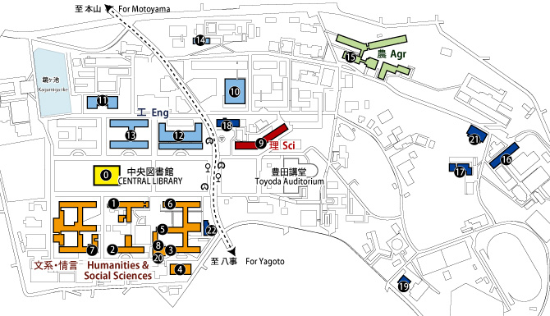
2.1 Using the Library
The outline of the Nagoya University Library (NUL)
★Guidance points：
The Central Library is not the only one library in Nagoya University.
NUL consists of more than 20 libraries.
Medical Library (Tsurumai Campus)/Library of Health Science (Daiko Campus)/Departmental libraries
There are in total 3.4 million materials in the whole NUL and 1.3 million of them are held in the Central Library.

Slide 11
2.1 Using the Library
Is the library a place for …
only borrowing books?
studying
group learning, presenting
searching for materials, consulting about studies
using PC, printing out
reading academic papers
using electronic resources (can be accessed also outside of the library)
etc.
※ Student ID is necessary to enter the library or borrow books or use PC
★Guidance points：
The difference of university and high school libraries
Not only reading and borrowing books
the place of ‘independent learning’ which takes you one step forward from the stage of ‘research based learning’
Scholarly articles are important
*On the arrangements and facilities of Central Library, see “Guide to Nagoya University Central Library” or the Tour guide “Central Library Tour for new students”

Slide 12
2.1 Using the Library: Rules and Manners
Before Using the library・・・
Return the books by due date
Use materials, equipment and machines carefully
Keep quiet in the library
Talking on a cell phone is not allowed except in designated areas
Carrying food and uncovered drinks is prohibited
Smoking is prohibited
There is no garbage can inside the library.(only at library entrance)
Pay attention to copyright law when copying materials
★Guidance points：
●Use carefully the property of Library
●Consider others
The materials, facilities and equipments are the property of library. The responsibility to keep them in good condition for coming generations is on you
Prohibition of eating and drinking in the library is not only for the purpose of good manners but also for the protection of materials and facilities
Keep the space pleasant for other people too

Slide 13
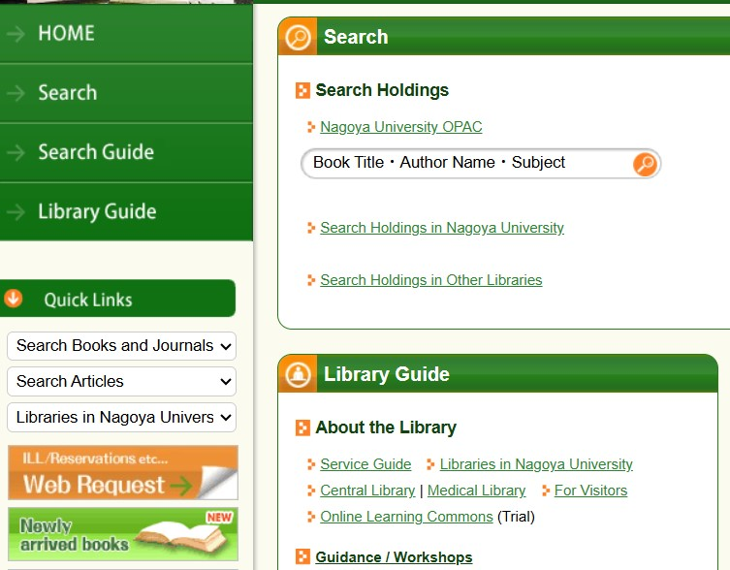
2.2 Searching for Books and Journals
Holdings in Nagoya University
If there are available
Where you can find
OPAC
＝Online Public Access Catalog
★Guidance points：
The place of the book cannot be searched by Google!
You can search from anywhere, anytime you want
You can access OPAC from PCs, Tabs, Smartphones, Cellphones

Slide 14
2.2 Searching for Books and Journals
In case of searching for books
Glenn D. Hook, et al. Japan's international relations : politics,
(1) (2)
economics and security 3rd ed. (The Sheffield Centre for
(3) (4)
Japanese Studies/Routledge series ; 44) Routledge, 2012.
(5) (6)
Words in red are available for Keyword Search
(1) Author or Editor
(2) Title
(3) Edition
(4) Book Series related information
(5) Publisher
(6) Publication year
In some cases (e.g. in syllabus) information other than title are blank.
★Guidance points：
‘Publication year’ is not available for Keyword Search

Slide 15
2.2 Searching for Books and Journals
In case of searching for journals or articles
Noyori R., Ohkuma T. (2001) “Asymmetric catalysis by
(1) (2) (3)
architectural and functional molecular engineering”
Angewandte Chemie : International Edition 40(1): 40-73.
(4) (5) (6)
Words in red are available for Keyword Search
(1) Author
(2) Publication year/date
(3) Article title★
(4) Journal title★
(5) Volume, number☆
(6) Page Number☆
Different from books
★2 kinds of title
☆Information of vol. and
numbers of pages
★Guidance points：
Show the sample of article
Check if they can differentiate between a book and an article
Only journal title can be used as a keyword

Slide 16
2.2 Searching for Books and Journals
Searching for Books in OPAC
You can use several words
Add asterisk (*) after the stem of the word → Truncation
Click on the title for details
You can narrow down by Material Type, Holding Library, Publication year, Language etc.

Slide 17
2.2 Searching for Books and Journals
Bibliographic and holding information (books)
☟There are 4 copies available within NUL and 2 of them are in the Central Library.
【Location】
Library & Area
(“Cent Lib …” = Central Library)
Click on Location to view map
【Call Number】
Book’s arrangement and subject
Labeled on the spine of the book
Holding information
★ Guidance points：
There are huge books, and they are divided and arranged in different areas
It is very important for finding books to take notes both of 【Location】 and 【Call No】
Bibliographic information

Slide 18
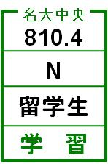
2.2 Searching for Books or Journals
Arrangement of Books
Order of Call Number
First column: Classification Number
Second column: Author’s symbol
The location differs according to types of books
– Books for undergraduates: 3F, Books for researchers: 1・4F,
Reference books: 2F
700
Classification No. →
Author’s symbol →
Info about Vol.& →
Bookshelf etc
Location →
Books placed near
= close topic
800

Slide 19
2.2 Searching for Books and Journals
Nippon Decimal Classification (NDC)
0：General works
1：Philosophy
2：History
3：Social Sciences
4：Natural Sciences
5：Technology
6：Industry
7：The arts
8：Language
9：Literature
410 Mathematics
420 Physics
430 Chemistry
・・・
460 Biology
461 Theoretical biology
462 Biogeography
463 Cytology
464 Biochemistry
464.1 Molecular Biology
464.2 Protein
464.26 Collagen
464.27 Nucleic Acid:RNA,DNA
・・・
470 Botany
480 Zoology
490 Medical sciences
★Guidance Points：
You can skip showing these tables to the participants but
Explain, when the numbers are close, the topic is also close
Show them the detailed classification of columns on the shelves

Slide 20
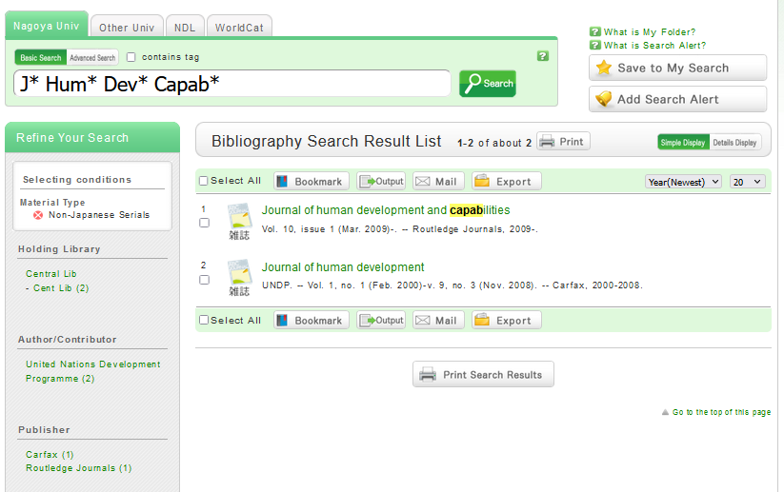
2.2 Searching for Books and Journals
Searching for Journals in OPAC
Search by ‘Journal title’
×article title
×author
×publication year
Click on the title for details
Refine by Material Type
You can also narrow down by Holding Library, Publication year, Language etc.

Slide 21
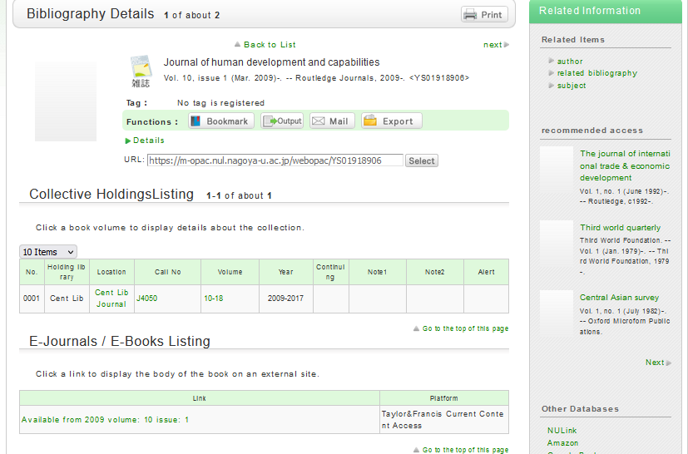
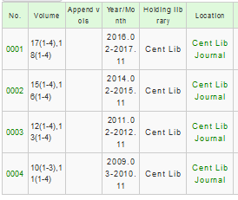
－Information on the Journal in OPAC－
☟The journal is located in one library (Central Library) in NUL
Make sure to check！
※The existing volumes are displayed here
Note that library may not hold all volumes!
Clicking the volume will show you holding information

Slide 22
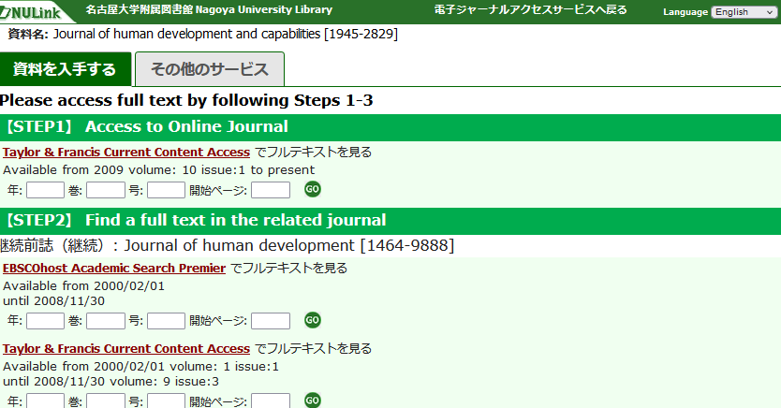
－ Information on the Journal in OPAC －
Displayed when the e-Journal is available

Slide 23
2.2 Searching for Books and Journals
Arrangement of journals
★ Guidance Points：
Journals have no call numbers in Central library. They are arranged by titles
Current year issues: 3F
Previous issues : B1 in bindings
Title Order → Year order → Order of each volume number
Show the articles by turning over the pages
Japanese： Kana order
Non-Japanese： Alphabetical order
The location differs according to types of journals and publication year
Current year issues: 3F
Previous issues: B1
Journals are bound after about a year
A
Same journals are arranged by publication year
B

Slide 24
2.3 Finding and obtaining materials
The procedure of obtaining the materials
NUL
Libraries in Japan
- University libraries
- Public libraries
- National Diet Library
Libraries abroad
Available
Borrowing,
Making copies
★ Guidance Points：
Even if you can’t find,
don’t give up!
Reaffirm whether it is really unavailable
You can search for materials in other libraries by CiNii Books, NDL OPAC, and so on
If it is available in other libraries, you can order or visit the library
Not available
Available
Ordering,
Visiting
Not available
Available
Ordering
Please ask library staff if you do not know how to search/order materials.

Slide 25
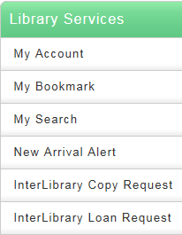
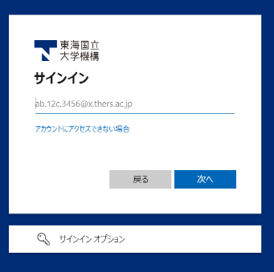
2.3 Finding and obtaining materials
Confirmation and renewal of your borrowing books
→In OPAC
Confirming your borrowed books, click on ‘Bibliography information’
Also confirm [Borrowing Lib] and [Due-Date]
on the left side of OPAC menu
Enter THERS account&Authenitication code.
Check the books which you want to renew, click on
※There are some libraries which cannot renew the books from “Library Services”

Slide 26
Cautions when you make copies
2.3 Finding and obtaining materials
Copyrighted works cannot be reproduced without copyright holder permission
Usage in the library includes an escape clause and may be copied in the following ranges (Copyright Act Article 31 Clause 1)
Where, in response to the request of a user of a library, etc. and for the purpose of his research or study, such user is furnished with a single reproduction of (a) a part of a work already made public, or (b) in the case of an individual work reproduced in a periodical already published for a considerable period of time, all of such individual work.
The rules of library
For the purpose of personal research and study
One person one copy
Do not exceed half of the entire part (periodical: Individual articles in any issue except the last one of a magazine or newspaper may be copied in its entirety)
An article in periodical can be reproduced after the publication of the next issue
Fill in the “application form of Copy Services”
＊Copy Machine inside the library is only for copying the library’s materials !
★Guidance points：
The rules of respect towards the author of books and articles
It is not allowed to make a copy the latest number of journals or newspapers
→ Today’s newspaper may not be copied
It is not allowed to make copies of personal materials such as notebooks, resumes of classes inside the library

Slide 27
2.3 Finding and obtaining materials
Visiting
Bring your student ID
Obey rules/manners of place of the visit
Letters of introduction sometimes is needed (Interlibrary Loan Desk)
Previous inquiry is needed sometimes, apply at least one week before you visit
Making ILL order
Order at your departmental library or Central Library
★Guidance points：
Not so many people are familiar with ILL service
When ordering books/copies from almost all Japanese Universities, NUL bears a part of the charge of them
Copy: full payment
Loan: one way cost
ILL service may take some time. Order books/copies with time to spare

Slide 28
2.4 When you need help
Ask the staff at library’s desks
Service Desk
Using the library in general
Application for using facilities
Consultation about searching for and obtaining materials
Support Desk
Ask graduate student staffs
Using PC, and if there is any trouble
Support your writing
Departmental libraries
‘Guidesheet’
Training courses, workshops
★Guidance points：
During the Library Tour introduce the desks and consultation time
Avoid the detailed explanations but emphasize ‘where to consult when they are in trouble’
Information about Training courses and events, see
Information screen in Central Library
NUL website,
Support Desk twitter account
… and so on

Slide 29
3. Additional details for the guidance
The period of First-Year Seminar
Academic writing process
Suitable resources
Deciding a topic
Thinking of keywords
Decide what book to read
Searching for articles
Decide what article to read

Slide 30
3.1 Academic writing process
At what stages of thesis writing materials are needed?
When you are given a task
When deciding on the topic
When making an argument
Complete article
5
stage
4
stage
Write introduction
3
stage
Create an outline of article
Task is given!
2
stage
Create an argument
１
Get evidence materials
stage
Study previous research
Deciding a topic
Develop a discussion
Acquire basic knowledge
Know outline
31

Slide 31
3.2 Suitable resources
Steps
Materials
★Guidance points:
(Common patterns)
Making conclusions by only using Wikipedia
Unknowingly searching by narrow keywords
Books are not found
Found articles are too difficult to understand
Without knowing the outline reading the treatise
↓
Advise them to start with introductory books
Get basic knowledge
Know outline
Decide topic
Develop discussion
Get evidence
Internet・Newspapers・Encyclopedias
General information・introductory textbooks
Specialized literature, research paper, statistical data, etc.

Slide 32
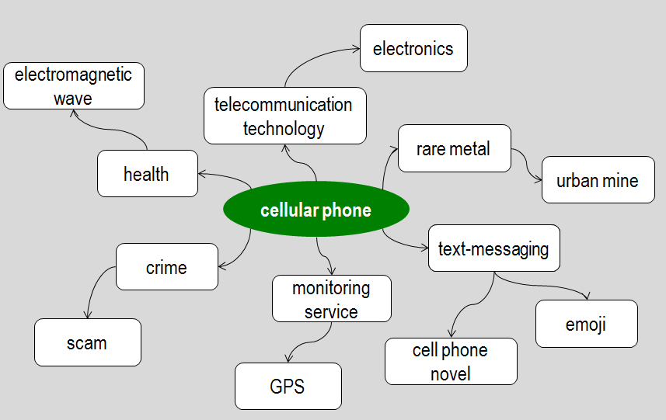
3.3 Deciding a topic
Write down related words
Think about question <Make a question using these words Who/What/When/Where/Why/How>
Refine angle, view, period, subject, method, and so on
★Guiding points:
Refine the size of the topic to reportable
If cannot study well, change direction later

Slide 33
3.4 Thinking of keywords
The keywords for searching materials
Think as many words as you can
Broader/narrower concept, synonyms, related words, different notations
Combination of words / narrowing down
Broader
Technology
Social Psychology
Electrical engineering
Communication
★Guidance points:
OPAC and databases do not search synonyms automatically as Google does
You should try entering different keywords by yourself
Find new keywords from search results
Correspondence
mobile, mobile phone (terminal)
cellular phone
Smartphone
Feature phone
iPhone
Android
Narrower

Slide 34
3.5 Decide what book to read
To evaluate a book
For reference materials for report reliable information is required
Does the book match your topic or step of research?
Reading for the purpose
Read only what is important to your purpose - “Skimming”
Search a clue for investigation - “Scanning”
Read critically, thoroughly - “Critical Reading”
★Guidance points：
Do not stick to the book you saw for the first time, compare with others.
Try to look at other books located near
Old looking books may be ”used often regular item”
Check why the book you have found is good
Read critically

Slide 35
3.5 Decide what book to read
Evaluation points
Colophon
(publication data)
Publication year: Choose the newer one
Author: Is he/she a researcher in this field?
Preface
Check objective and assumed readers (e.g. “For undergraduate students…” )
Table of Contents
Grasp outline
Edition: Updated editions
Search for required topics
Index
Search for required topic
Check keywords (further clues)
References
References to be read next and to know basic references
Others
Highly Cited
Used by many

Slide 36
3.6 Searching for articles
Database
Japanese / foreign articles
Discipline
Newspaper articles
・・・
If you need,
you can use the list
of the databases
★Guidance points:
If necessary show how to search articles
If you need more specialized resources than books
There are few books on your topic …and so on

Slide 37
3.6 Searching for articles
★Guidance points：
General explanatory article about academic topics：
theory/application of technology
influence on society/economy
The effective source for topical themes
<Restriction of simultaneous access. Please make sure to log out within proper time>
Newspaper articles
Finding the newest topics
Reading commentaries
Database
LexisNexis Academic
ProQuest
Refer to： Search > Databases> Newspapers https://www.nul.nagoya-u.ac.jp/db/index_e.html#sinbun

Slide 38
－ Reviewing the Search Results －
Searching in OPAC or other databases …
Few or no results
Too many/specific keywords
Misspellings/different notations
Too many result
Too few/broad/general keywords
★Guidance points：
Pay attention not only on operation of search but also check how appropriate are the results
No results don’t mean no materials. Don’t give up and try to search several times
Search by more general (broad) keywords
OR search
Check helps or input examples
Search by more specific (narrow) keywords
Add keywords
Limit search by date etc.

Slide 39
3.7 Decide what article to read
Evaluation points
Bibliographic information
Year: Newer (excl.: classics, basic)
Journal, author：reputation in the field
Abstract
Grasp the content of the outline
Keywords
Look for required topic
References
Search for reference to read next
Citation
Mentioned, cited by many people <Highly cited>
Check for terminology (clues for next inquiry)
No references → It is not academic article
Body of article
Logic, neutrality, diversity, scientific basis
Popularity of topic, uniqueness of view

Slide 40
４.EXPERIENCING A LIBRARY TOUR
Please experience how to hold a library tour and learn about demonstrating and practicing points.

